Slide 1

The Talking Mailbox
LoRa-WAN Post Detection System
By Abhinav Kothari (33349) and Justin Chin Cheong (34140)

Slide 2

Problem
Professors/Instructors have a lot to do, and don’t always have the time to see the mailbox
Checking for mailbox and finding nothing can be annoying and a waste of time
Posts can remain unchecked for a long time if professor is busy
No way of knowing if post received if away (e.g., on conference/vacation)
Notes:
AK

Slide 3

Requirements
Detect mailbox opening
Detect mail status (no mail, light or heavy mail)
Communicate mail status remotely
Notes:
AK

Slide 4
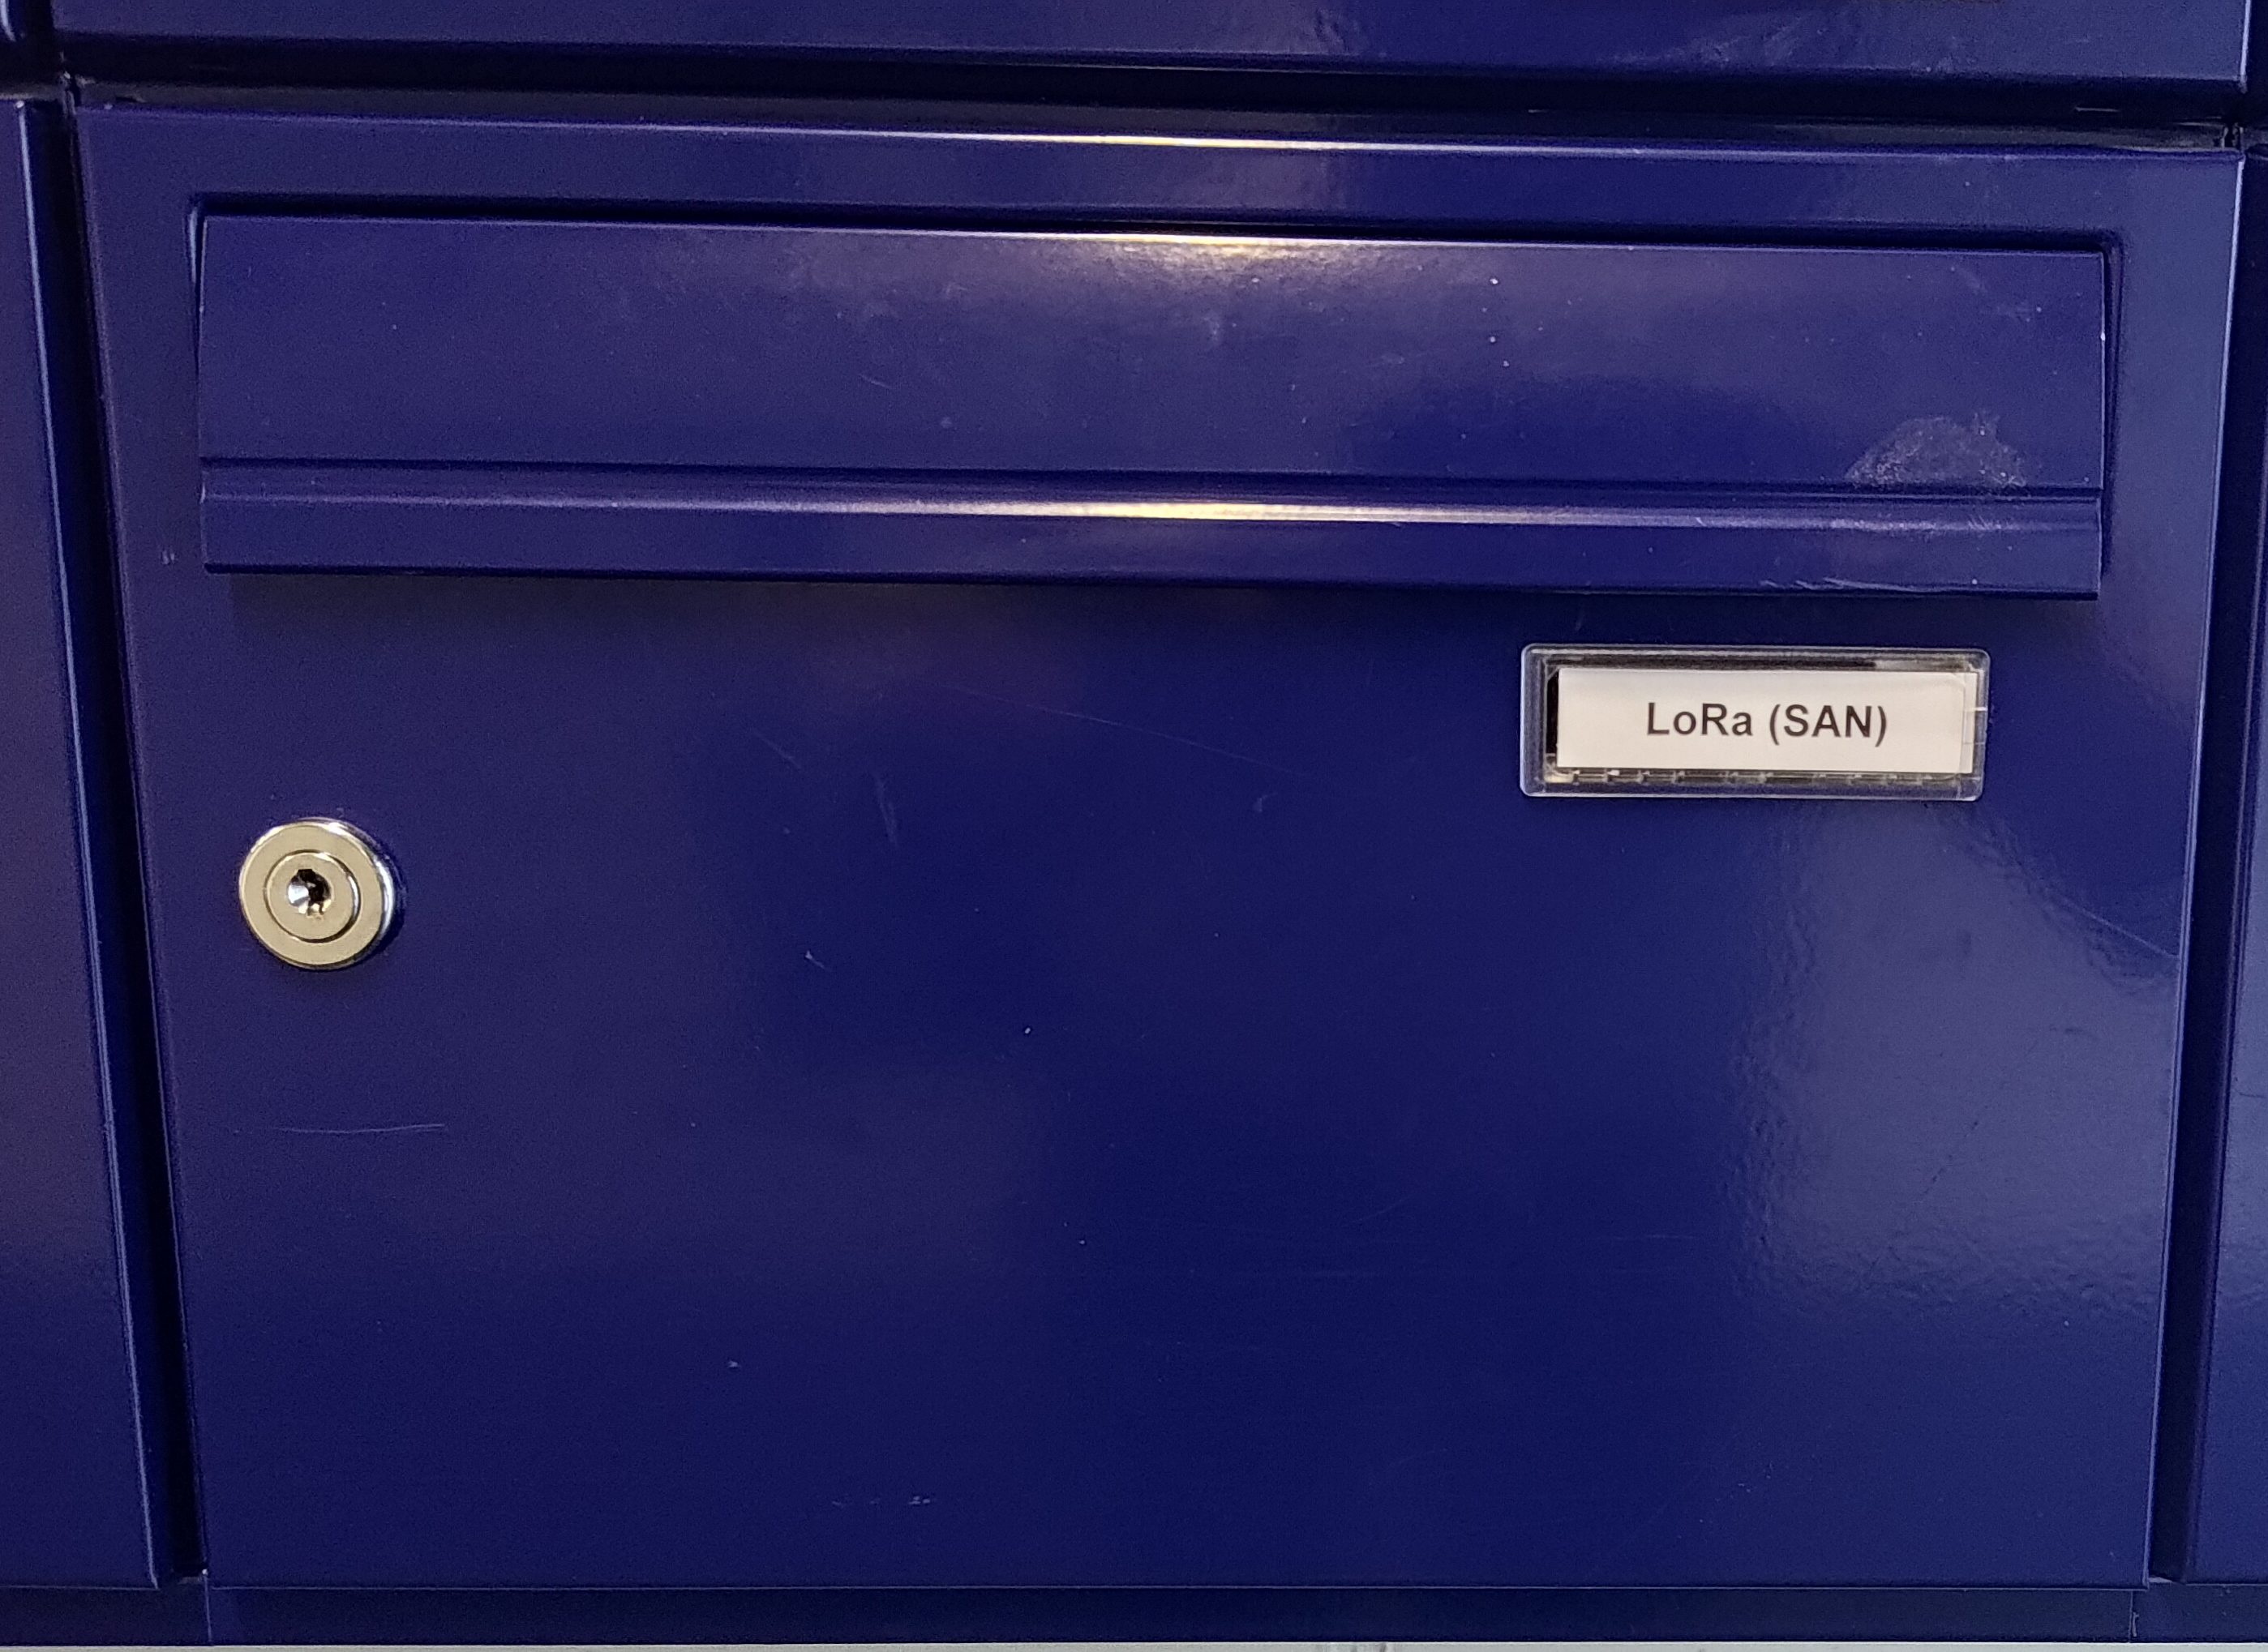
Outline
Existing Products
System Design and Process
Results
Potential Improvements
Notes:
AK

Slide 5

Existing Products
A Review of Products on the Market
Notes:
JCC

Slide 6

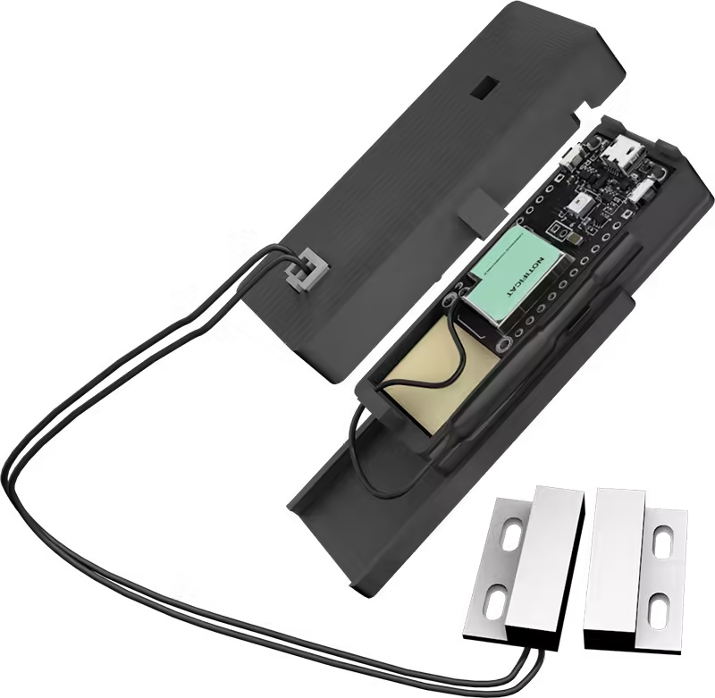
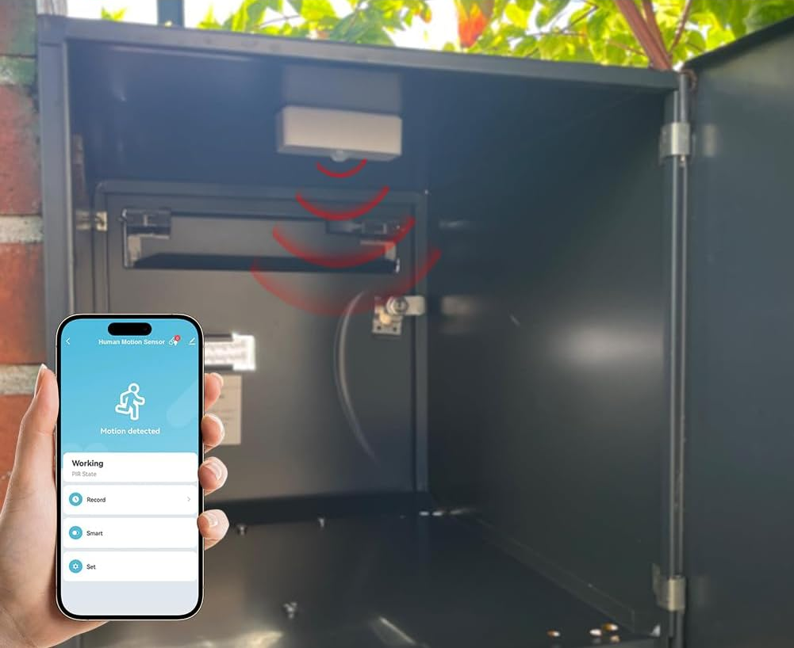
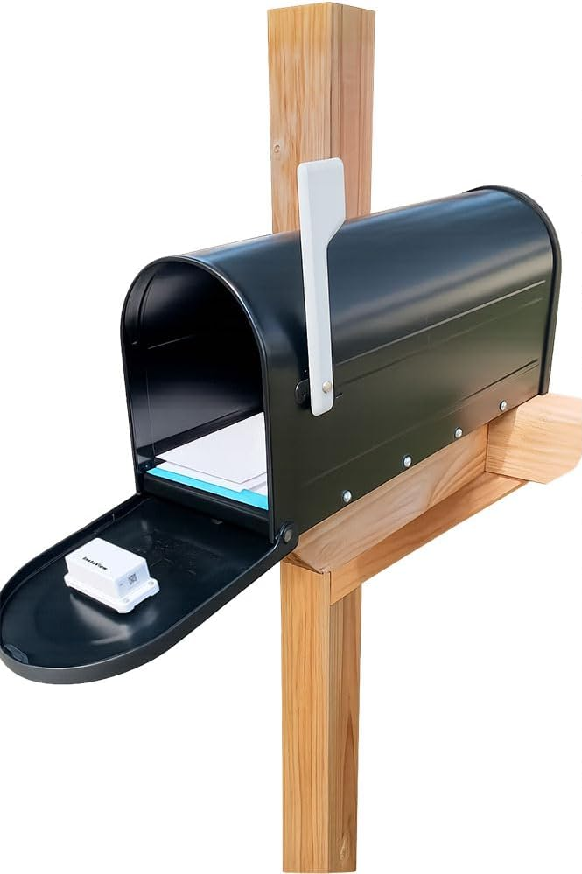
Existing Products
Notific-at
Fouvin
InstaView
X-Sense
Notes:
JCC DO THIS VERY FASSTTTTT BITTTEEEEEE
These are four products that exist on the market that attempt to solve this problem
Notific-at – contact sensor + lora
Fouvin – PIR motion sensor + Wifi
InstaView & X sense – tilt sensor on door + base station, X sense has back up motion sensor
Flaw in all – infer mail status, not measure
What if someone opens the mailbox but doesnt put in mail or take out?

Slide 7

System Design
Design, Process, Issues and Solutions
Notes:
AK

Slide 8
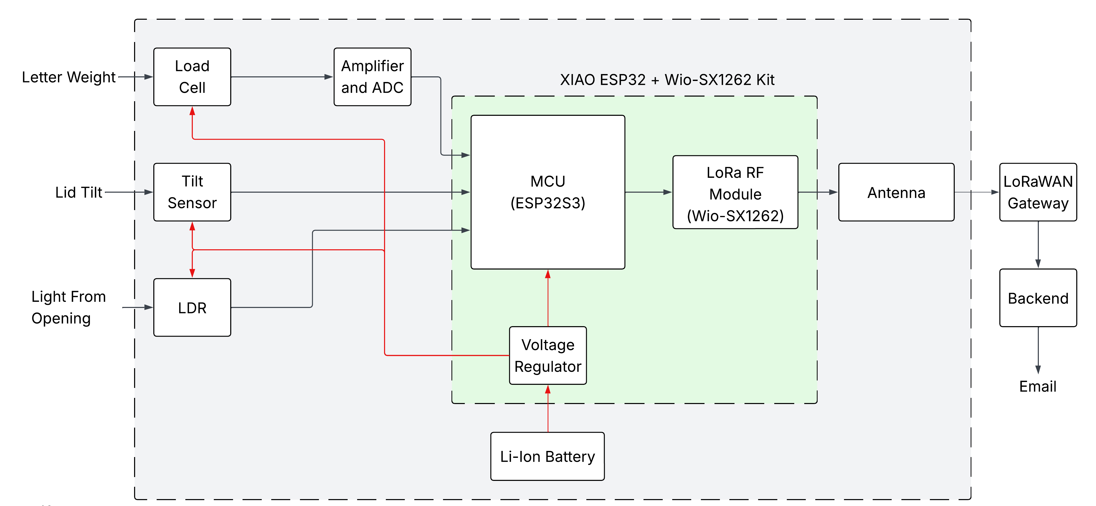
System Architecture
Notes:
AK
3 sensors all fed into MCU
MCU uses lora module to connect to LoRaWAN and then to back end
Entire system powered by Li-ion Battery and on-board voltage regulator

Slide 9
Bill of Materials
Component | Description | Price [EUR]
Weight Sensor | JOY-IT Load Cell + HX711 | 6.40
Digital Tilt Switch | IDUINO Ball Tilt Switch | 0.94
Digital Light Sensor | Sertronics LDR | 1.35
MCU + LoRa Module | Seeedstudio Xiao ESP32 + Wio SX1262 | 11.68
Antenna | Amphenol 868MHz long range | 2.69
Battery | SOLDERED 1800mAh Li-Ion Pouch | 10.24
Housing | Load Cell platform | 11.50
Misc. Electronics | Wires, Resistors, Breadboard, etc | 1.00
Total (+ 20% VAT) |  | 54.96
Notes:
AK
Briefly mention each sensor
Say cost can be reduced by developing a pcb instead of dev boards

Slide 10
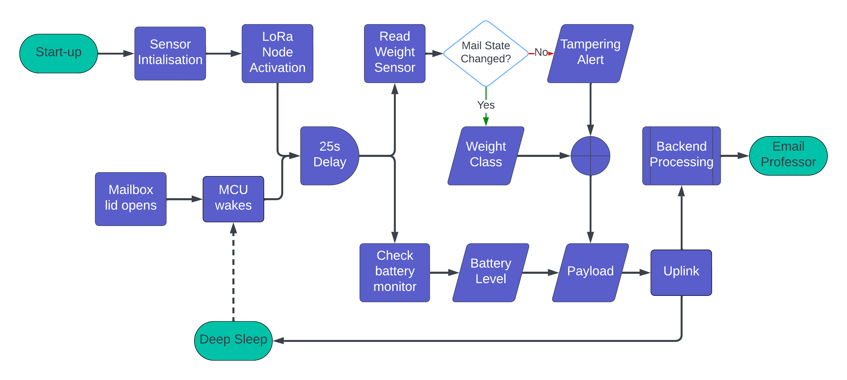
System Flowchart
Notes:
JCCC
Explain flow

Slide 11


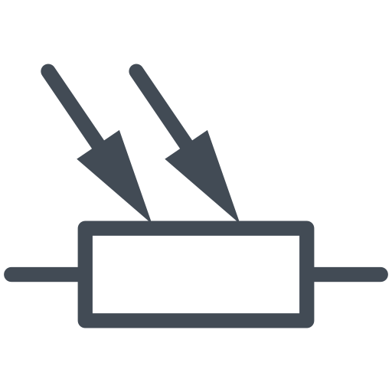
System Development
Sensor Interfacing
Notes:
AKK
Moving on the actual development of the system
We started with sensor interfacing.

Slide 12
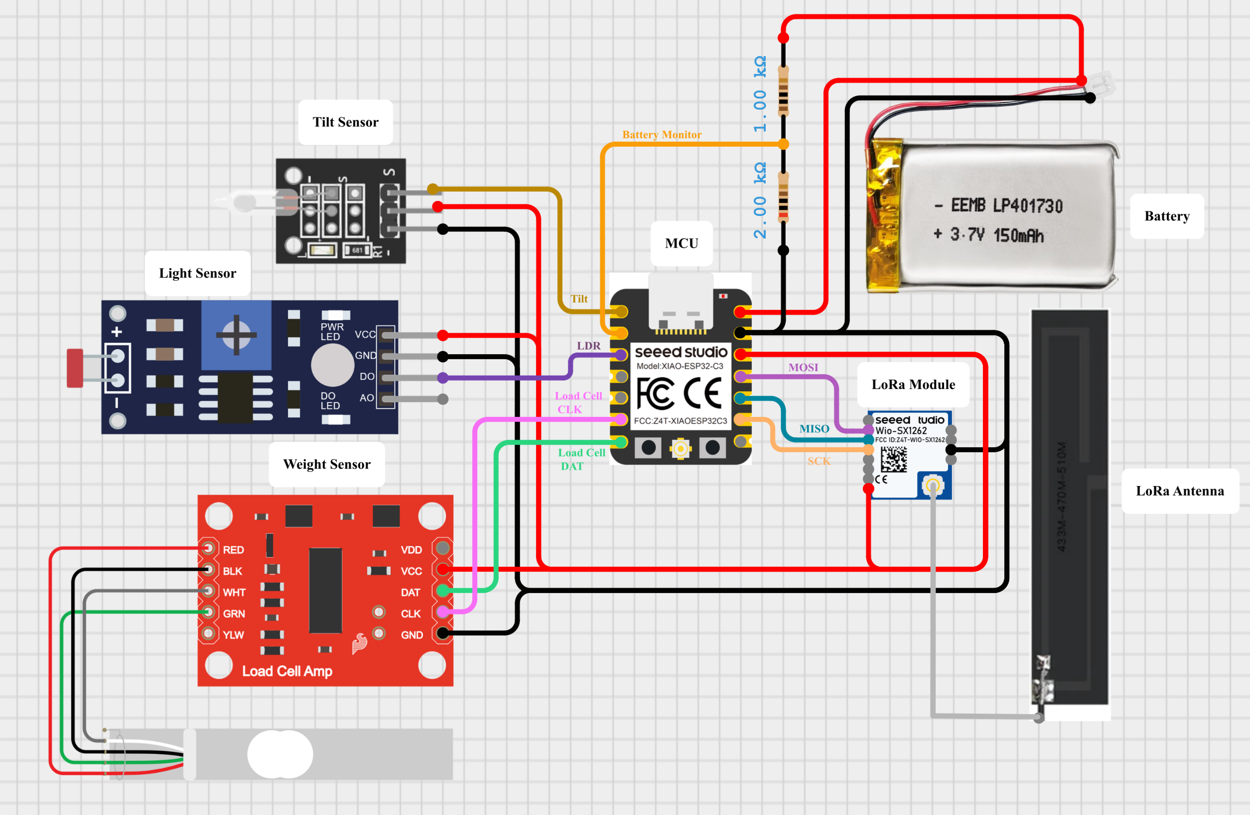
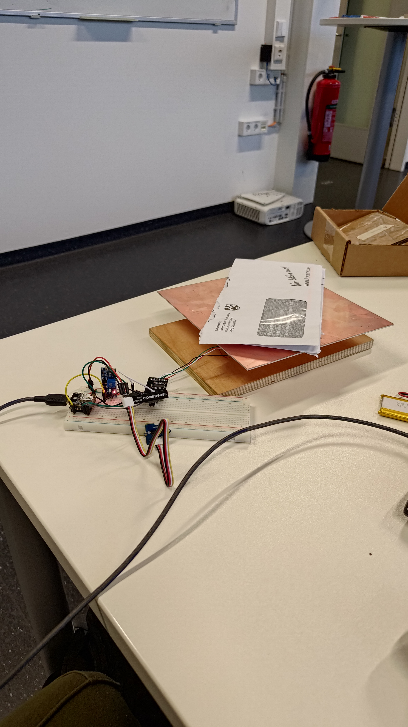
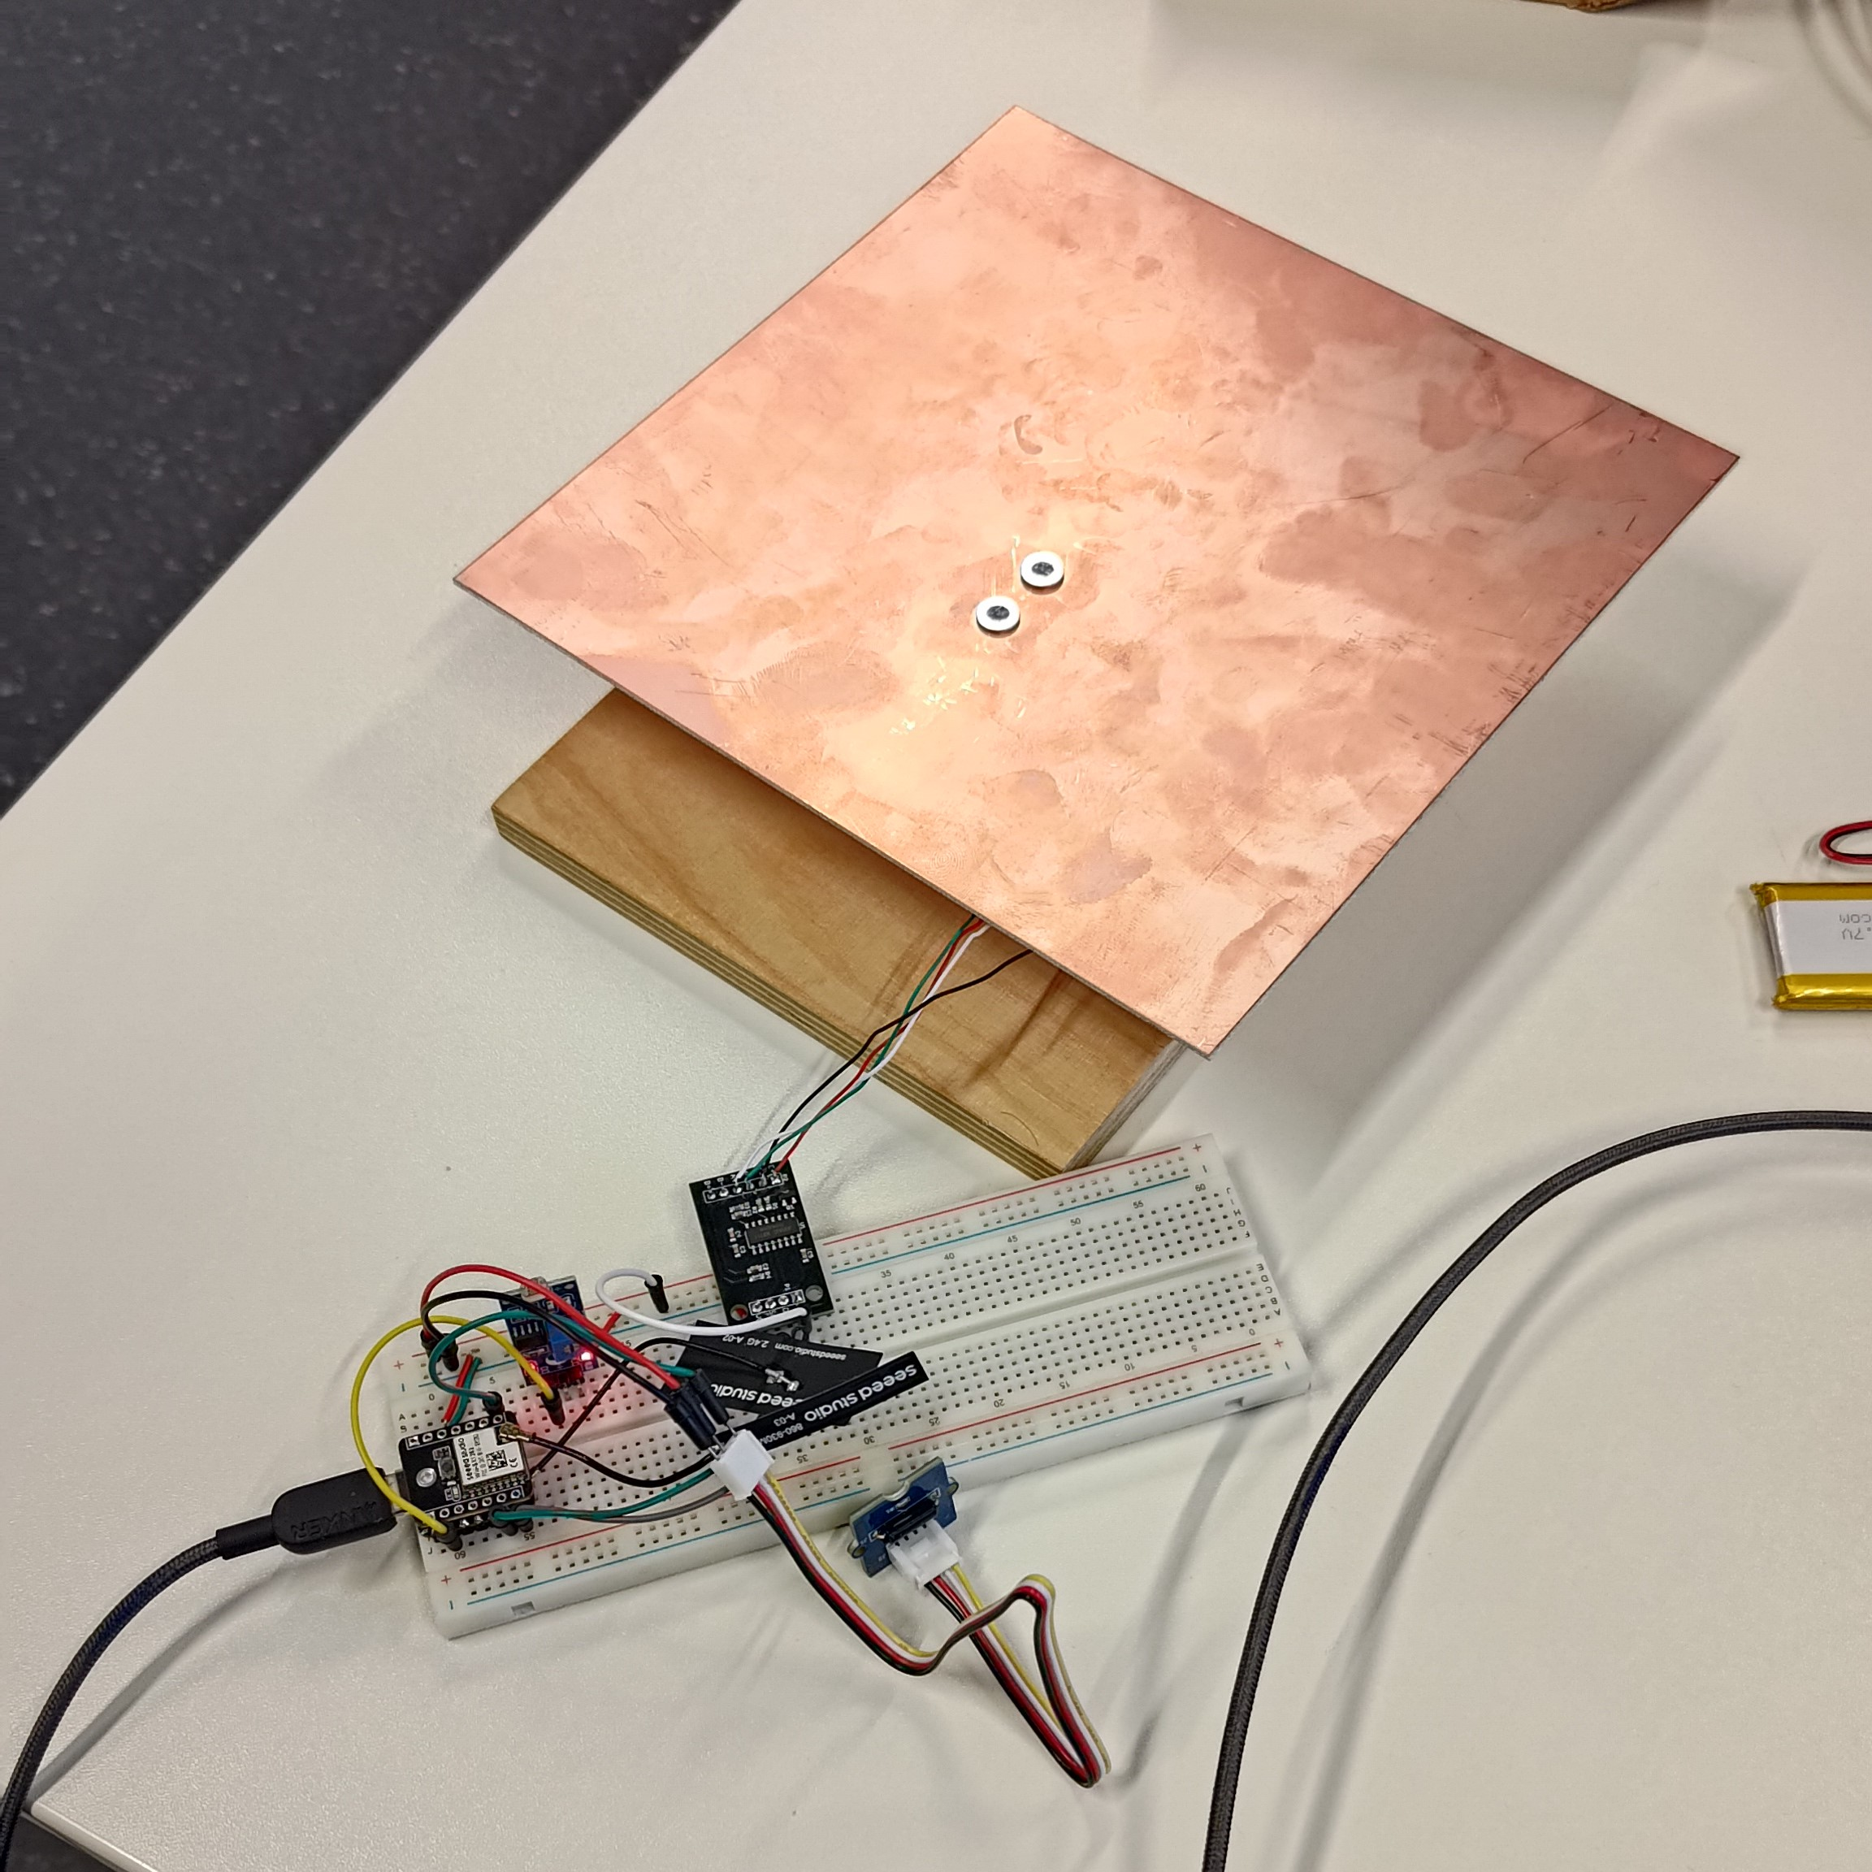
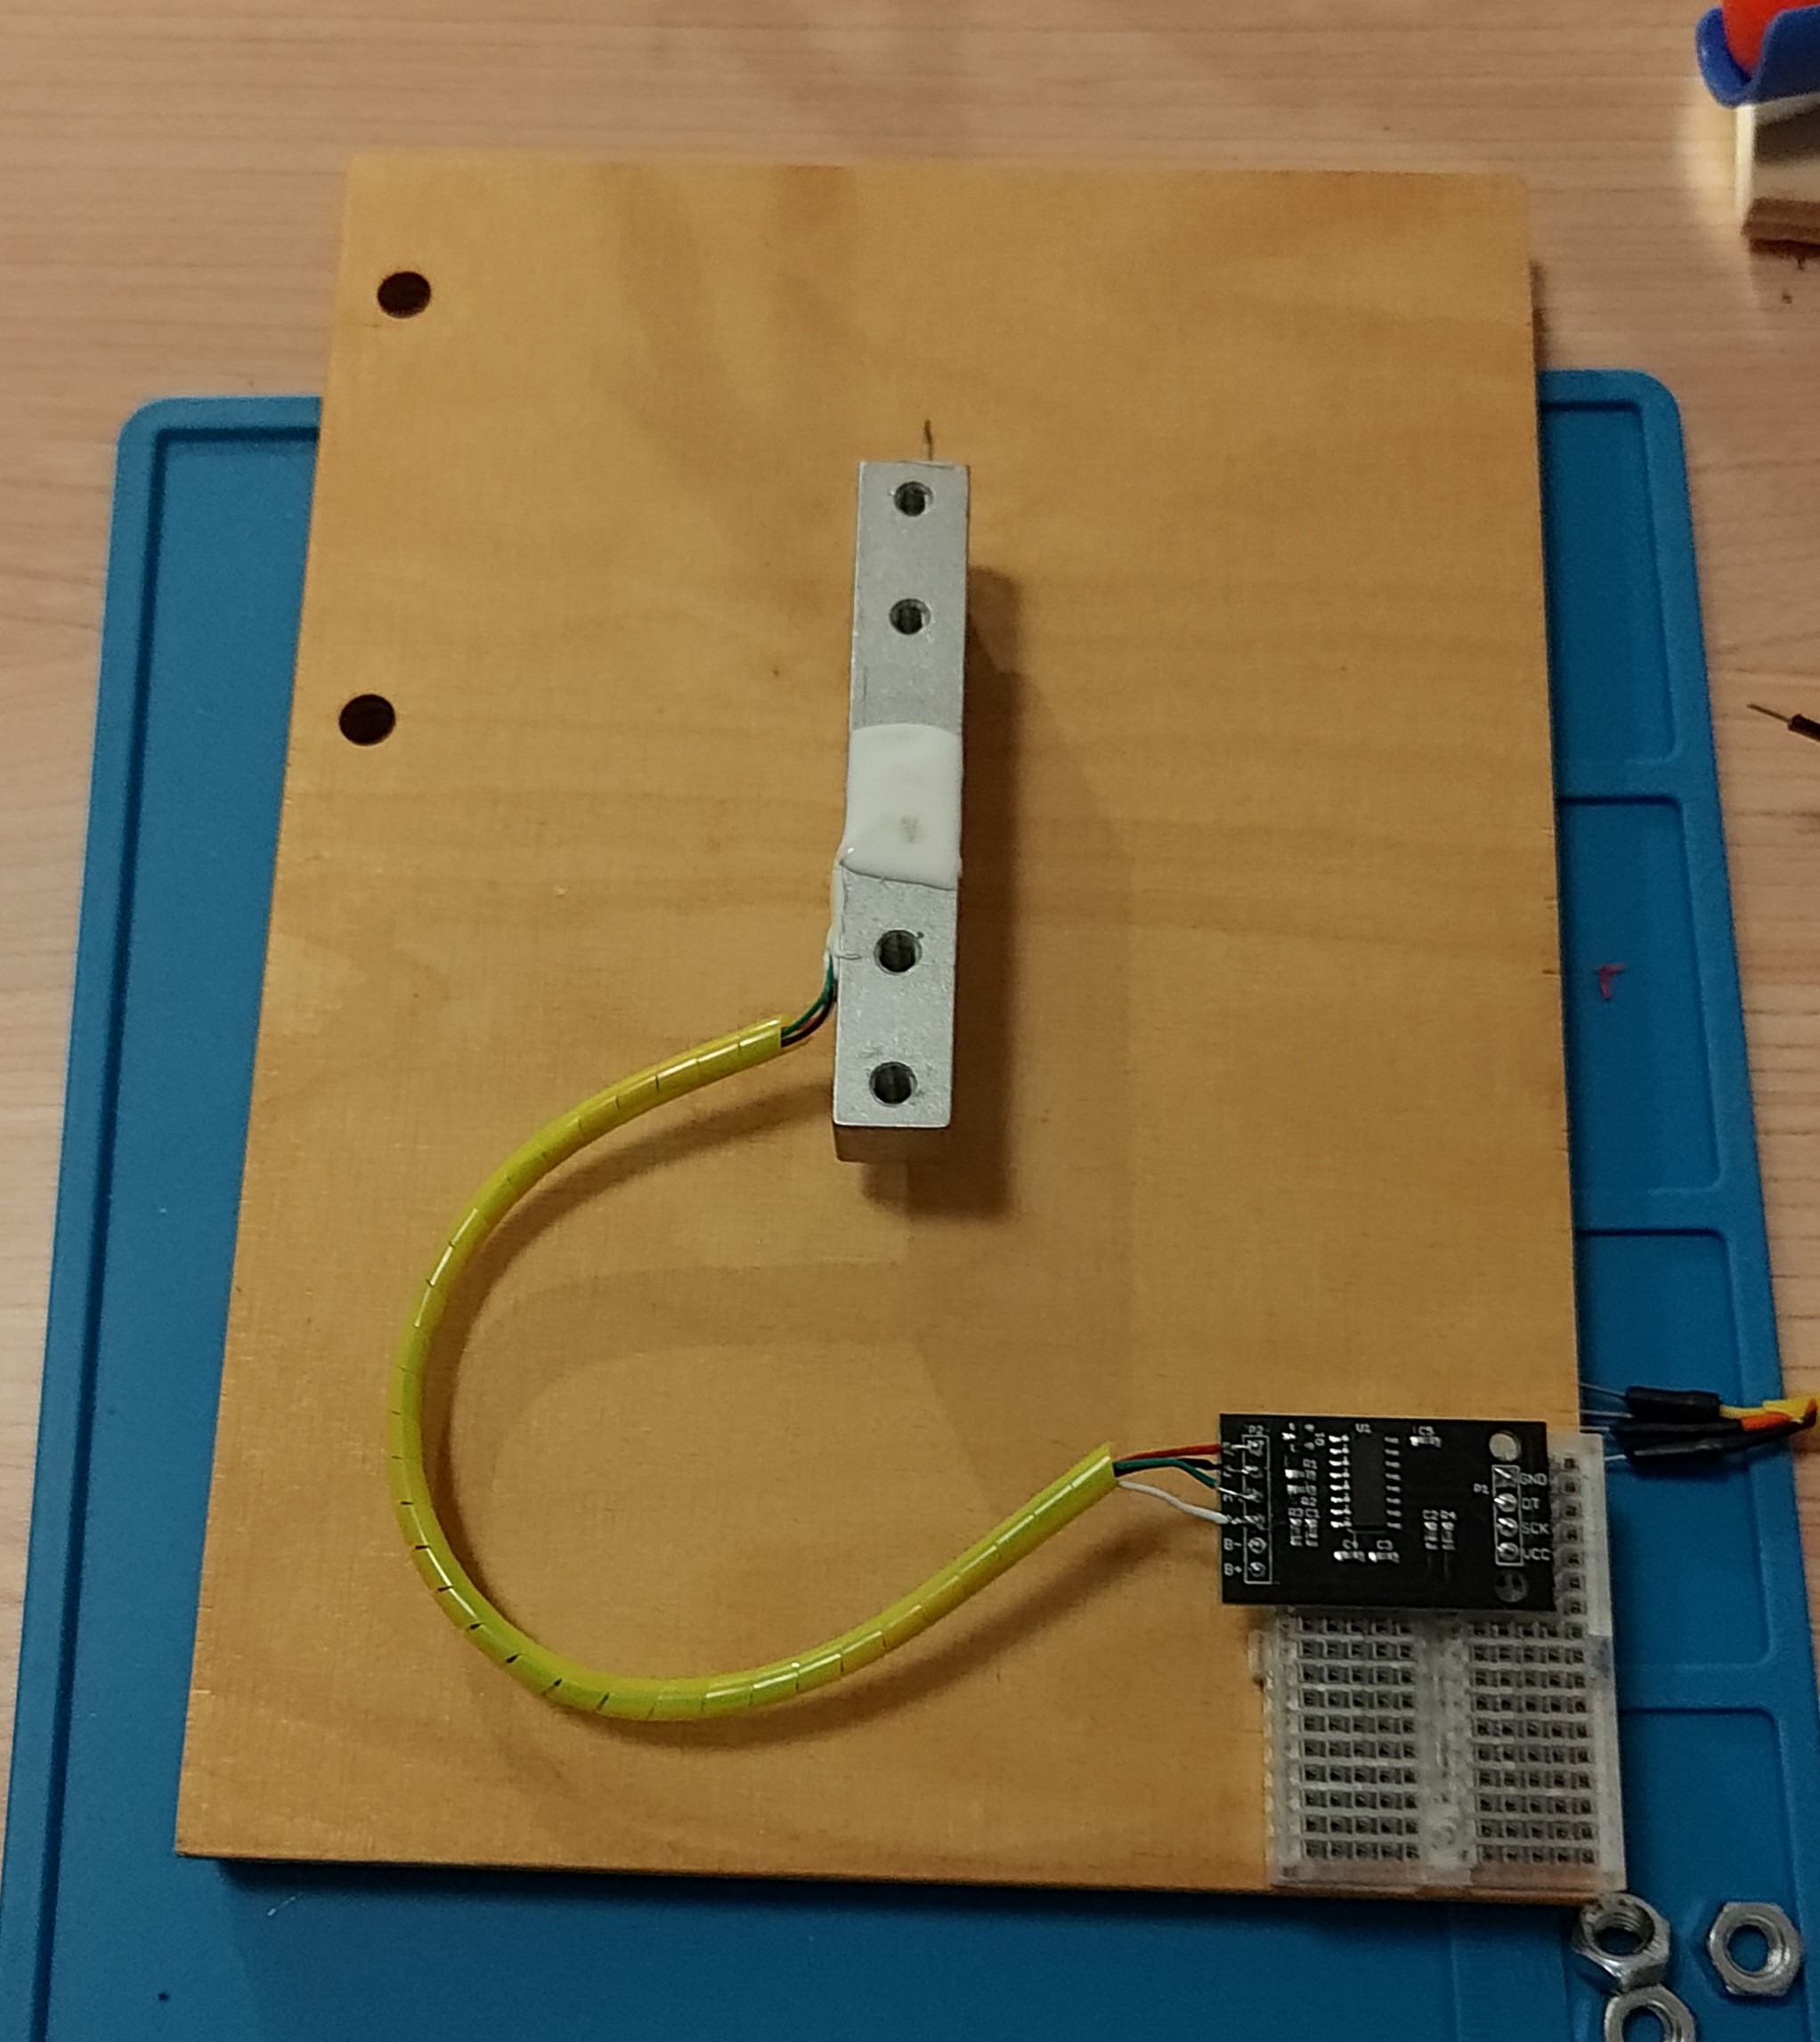
Sensor Interfacing
Notes:
AKK
Given that the LDR and tilt sensors were both digital sensors, the actual connections were rather straight forward
The only complications were with the HX711 which needed a platform

Slide 13
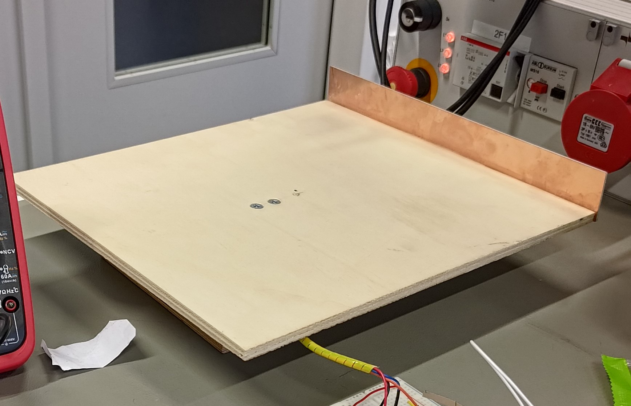
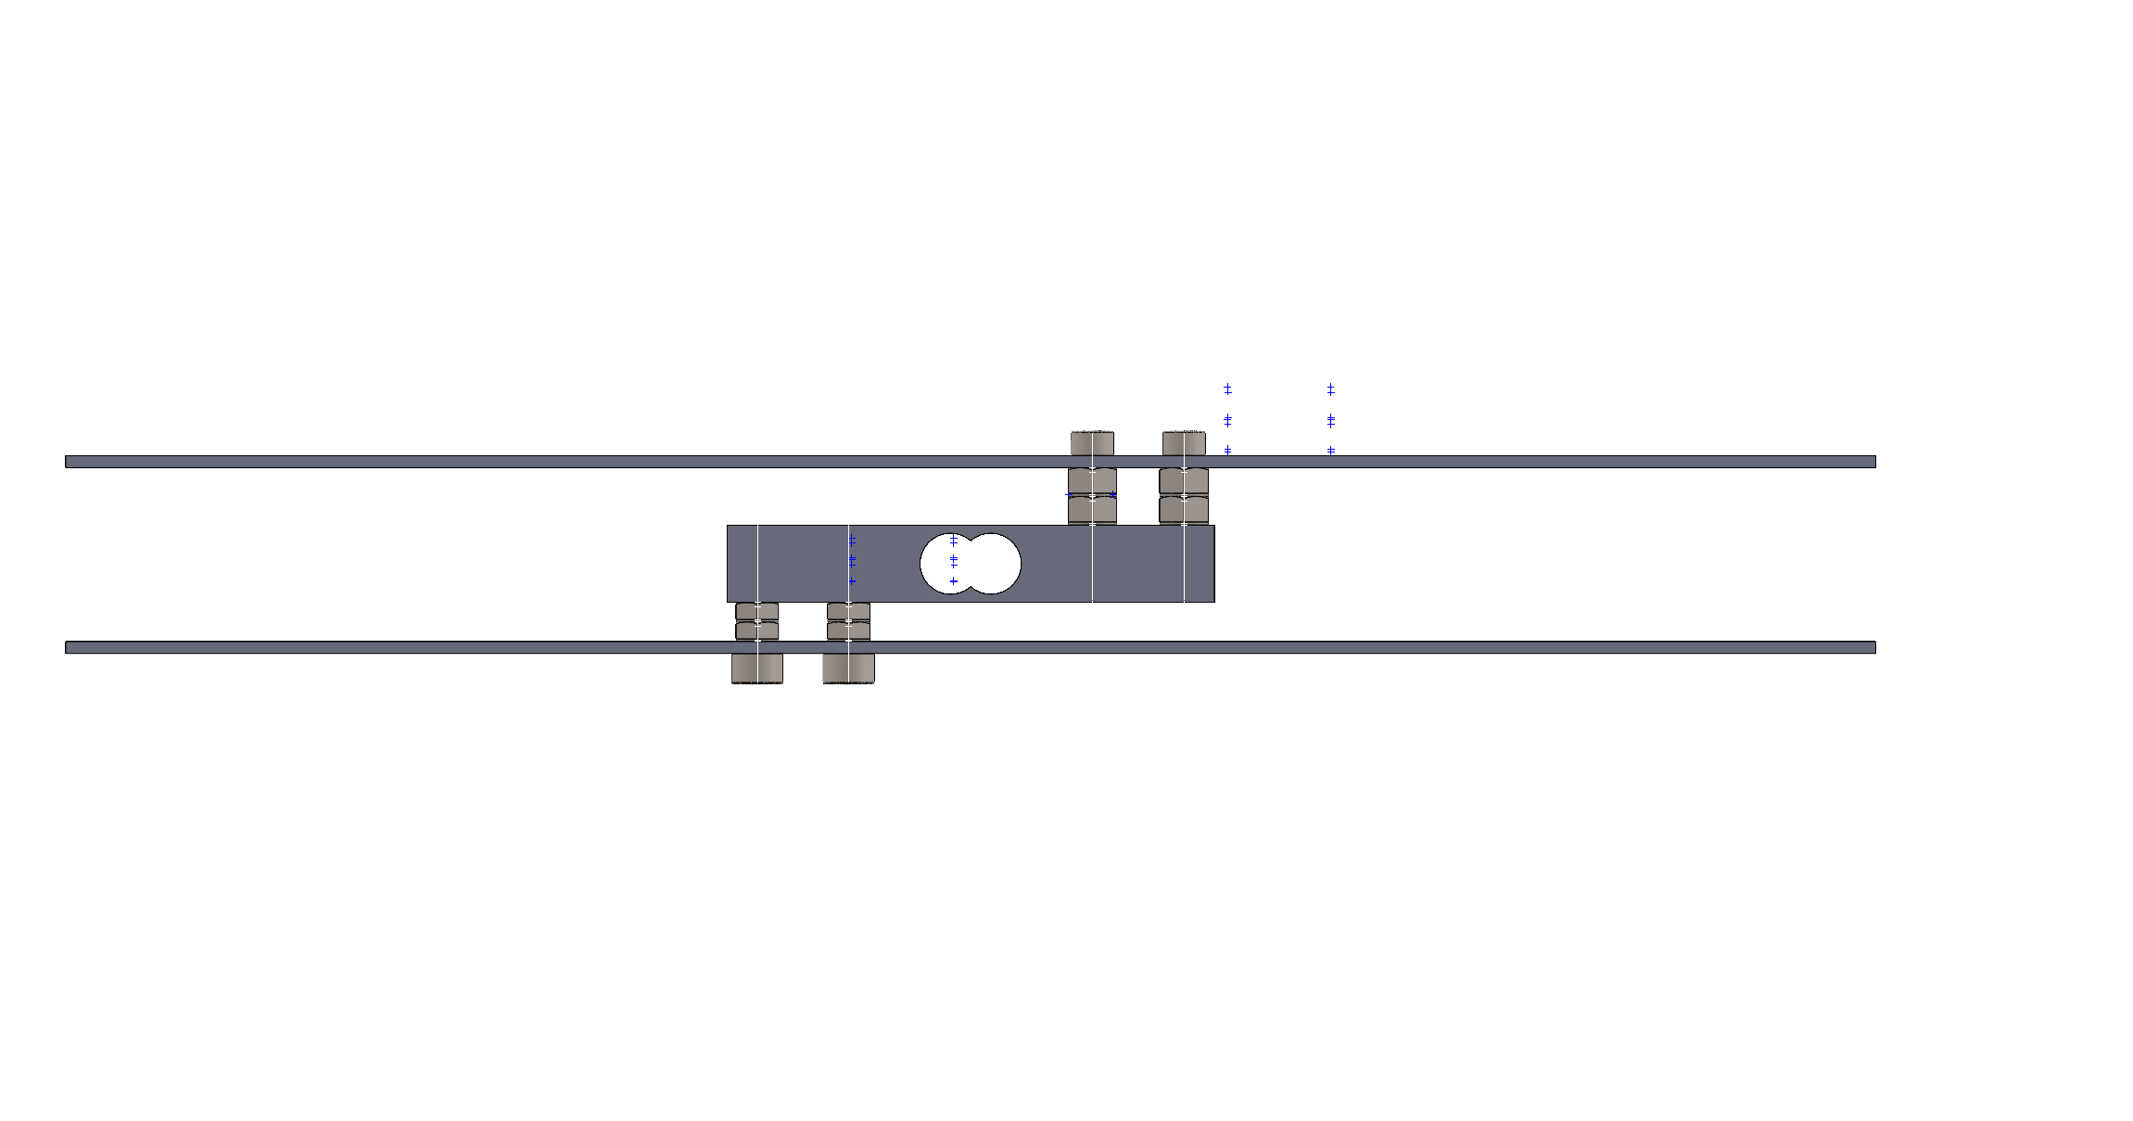
Sensor Interfacing
Load Cell Platform
Notes:
AKK
To ensure the load cell bends as easily as possible, it must be installed into a platform
We see that there is a distance between the plates and the cell itself to ensure sufficient deformation
However, the load cell also another important design process - calibration

Slide 14



System Development
Communication
Notes:
JCC
The next stage in development was the communication

Slide 15

LoRaWAN
Website/Mail
Application Layer
ESP32 + SW1262
LoRa Antenna
Legend Communication
Wired LoRaWAN Internal server
Notes:
JCC
We know that out system has a LoRa antenna but how exactly does it connect to the application layer

Slide 16



LoRaWAN
Website/Mail
RadioLib
Application Layer
ESP32 + SW1262
LoRa Antenna
LoRaWAN Gateway
Legend Communication
Wired LoRaWAN Internal server
Internet
Notes:
JCC
Well, we decided to use The Things Network via the RadioLib library for Arduino
We essentially connect to the TTN via LoRaWAN and then on the backend, the payload is decoded and sent to the user

Slide 17

LoRaWAN
Re-Joining Issue
Website/Mail
RadioLib
Application Layer
ESP32 + SW1262
LoRa Antenna
LoRaWAN Gateway
Legend Communication
Wired LoRaWAN Internal server
Internet
Notes:
JCC
However, we encountered a major problem when using TTN
Whenever the device power cycles or wakes from sleep, it took increasingly longer to join TTN (up to 30 mins)
This was because TTN requires the device to verify something called a devnonce when joining, but this value changes every session and the device doesn’t store it so it had to start over.
Basicallu all the join request were rejected

Slide 18

LoRaWAN
Re-Joining Issue
Website/Mail
RadioLib
Application Layer
ESP32 + SW1262
LoRa Antenna
LoRaWAN Gateway
Legend Communication
Wired LoRaWAN Internal server
Internet
NVM
Notes:
jCC
To solve this we implemented a persistent system, so the device stores the dev nonces in the NVM of the ESP32
So whenever it attempts to rejoin it uses the previous DevNonce and can join much faster or even instantly

Slide 19






Decode the Payload
Application Layer
Device ID
Data
server.py
Website
Mail
Machine
Notes:
AK

Slide 20
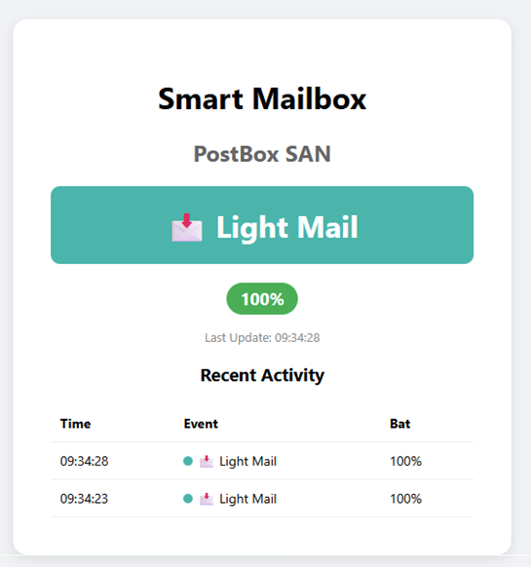
Application Layer
Website
Notes:
AK

Slide 21

Results
Demonstration
Notes:
JCC
Finally, now that ive sufficiently bored you, we can bring you back to life by seeing the systems performance

Slide 22
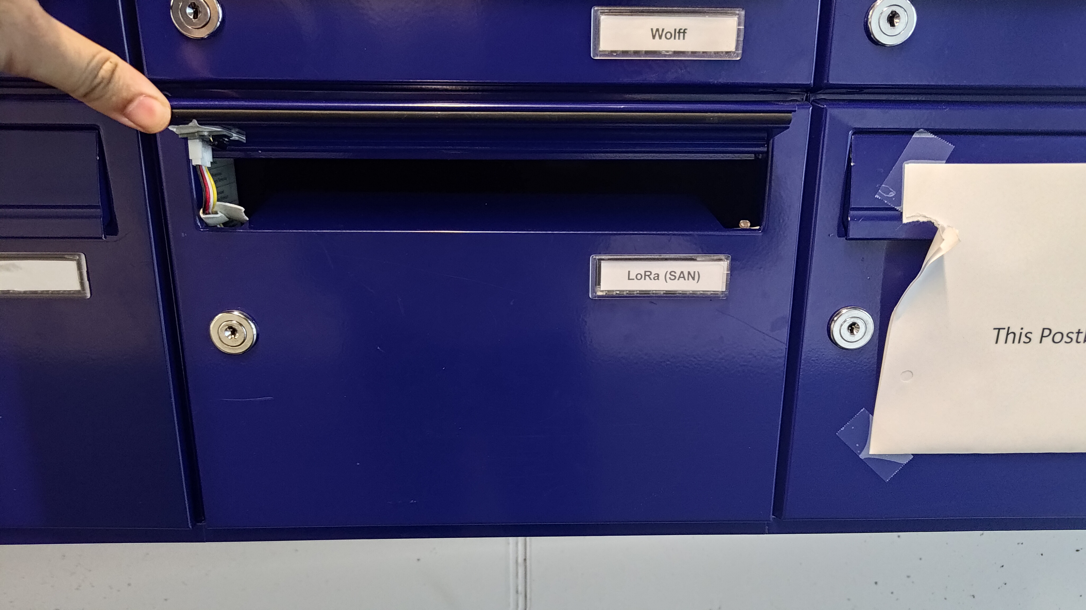
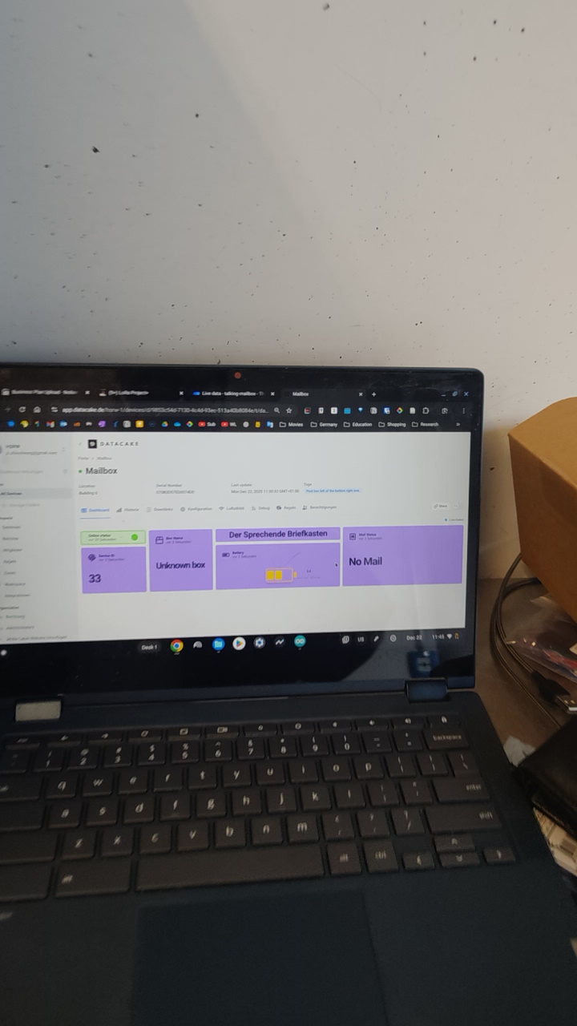
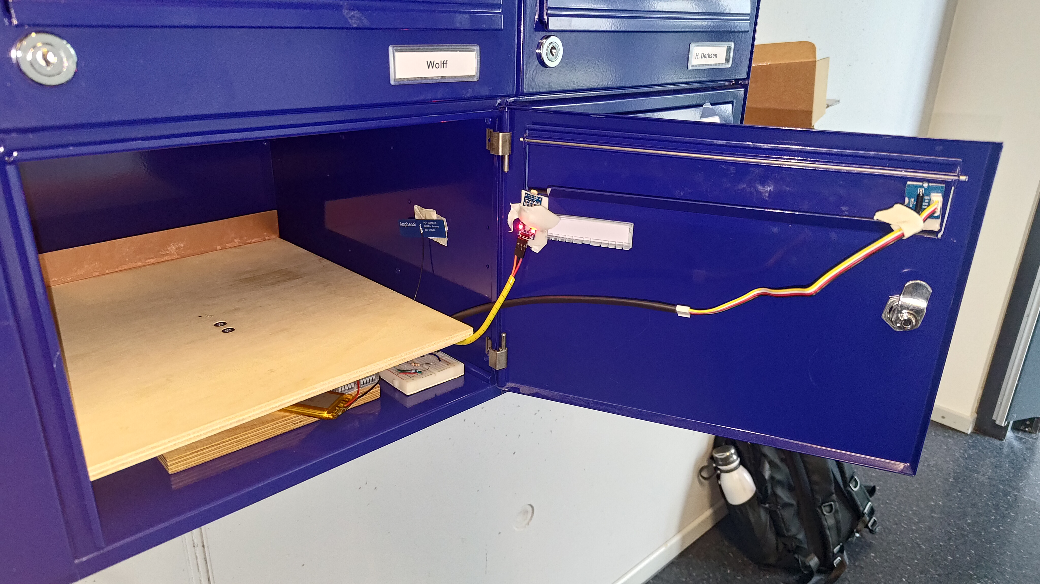
Demonstration
Notes:
Isaiah
What better way to show how the system performs than with a live demonstration

Slide 23

Potential Improvements
Possible future work and improvements
Notes:
AK

Slide 24
Ideas for the Future
Improved housing design: Integrate electronics directly into the load-cell platform for better protection and fit.
Local server deployment: Host the backend on a Raspberry Pi for local access and greater control.
Audible tamper alert: Add a buzzer to alert nearby users when tampering is detected.
Low Power Design: Removing all unnecessary auxiliary electronics to reduce power consumption.
Multi-mailbox support: Expand the system to monitor multiple mailboxes using device IDs and multiplexers.
Notes:
AK

Slide 25
Conclusion
Notes:
Both

Slide 26
Thank You
Any questions?

Slide 27
References
Fouvin. (2025). Mailbox sensor with remote monitoring via tuya app. Amazon. Re-trieved from https://www.amazon.de/Bewegungssensor-Intelligenter-Bewegungsmelder-Heimsicherheit-Fern%C3%BCberwachungs/dp/B0DDGGDMPX/ (Accessed: 2025-12-29)
InstaView. (2024). Long-range mail arrival indicator device. Amazon. Retrieved from https://www.amazon.com/InstaView-Delivered-Notification-Long-range-Indicator/dp/B0DPDRX6MG(Accessed: 2025-12-29)
Notific. (2025). Smart mailbox sensor. Notific.at. Retrieved from https://notific.at/en (Accessed:2025-12-29)
X-Sense. (2025). Smart briefkastensensor sma51. Bigshopper. Retrieved from https://bigshopper.de/product/x-sense-smart-briefkastensensor-erfordert-sbs50-basisstation-funk-melder-mit-grosser-reichweite-fuer-briefkaesten-briefkasten-alarm-zugestellte-post-sma51-2941520710.htm? (Accessed: 2025-12-29)

Slide 28
Attribution Links
Some icons were used from flaticons, here are the attribution links:
https://www.flaticon.com/free-icons/light-dependent-resistor : Light dependent resistor icons created by verluk – Flaticon
https://www.flaticon.com/free-icons/antenna : Antenna icons created by Freepik – Flaticon
https://www.flaticon.com/free-icons/spirit-level : Spirit level icons created by juicy_fish – Flaticon
https://www.flaticon.com/free-icons/decode : Decode icons created by Freepik – Flaticon
https://www.flaticon.com/free-icons/id : ID icons created by Indra Maulana Yusuf – Flaticon
https://www.flaticon.com/free-icons/business-and-finance : Business and finance icons created by Metami septiana – Flaticon
https://www.flaticon.com/free-icons/web-layout : Web layout icons created by Icon home – Flaticon
https://www.flaticon.com/free-icons/serpent : Serpent icons created by Mihimihi - Flaticon

Slide 29
Functional Requirements
For The Talking Door to be a satisfiable product, the following functional requirements must be implemented:
It can detect whether or not mail is present within the mailbox
It can detect if the mailbox is opened
It can check the battery status
It can communicate if a mail is in the box to a website (based on LoRaWAN)
It can detect light as a redundancy for confirming the opening status of the mailbox
It alerts the responsible person via email or dashboard upon mail detection
It sends battery status updates to a website every hour
It sends a low battery warning to a website when the battery falls below a defined threshold

Slide 30
Technical Requirements
For The Talking Door to operate and perform its functions, the following technical requirements must be implemented:
The weight sensor can detect a change in weight of approximately 20g. This indicates when a piece of mail has been placed within the box.
The tilt sensor can detect the rotation of the post box lid. This indicates when the lid is opened.
The LDR can detect the change in light intensity by a defined threshold. This indicates when the lid is opened.
The transmitter can reliably connect and communicate via the LoRaWAN Gateway.
The server with which the LoRaWAN communicates can send emails to relevant personnel about the mail.
The power supply is a battery with a working voltage of 3.1V to 4.2V.
The enclosure can protect the system within a typical indoor environment (IP31).
The system should function at temperatures ranging 0--40°C and humidity 10--90%.

Slide 31
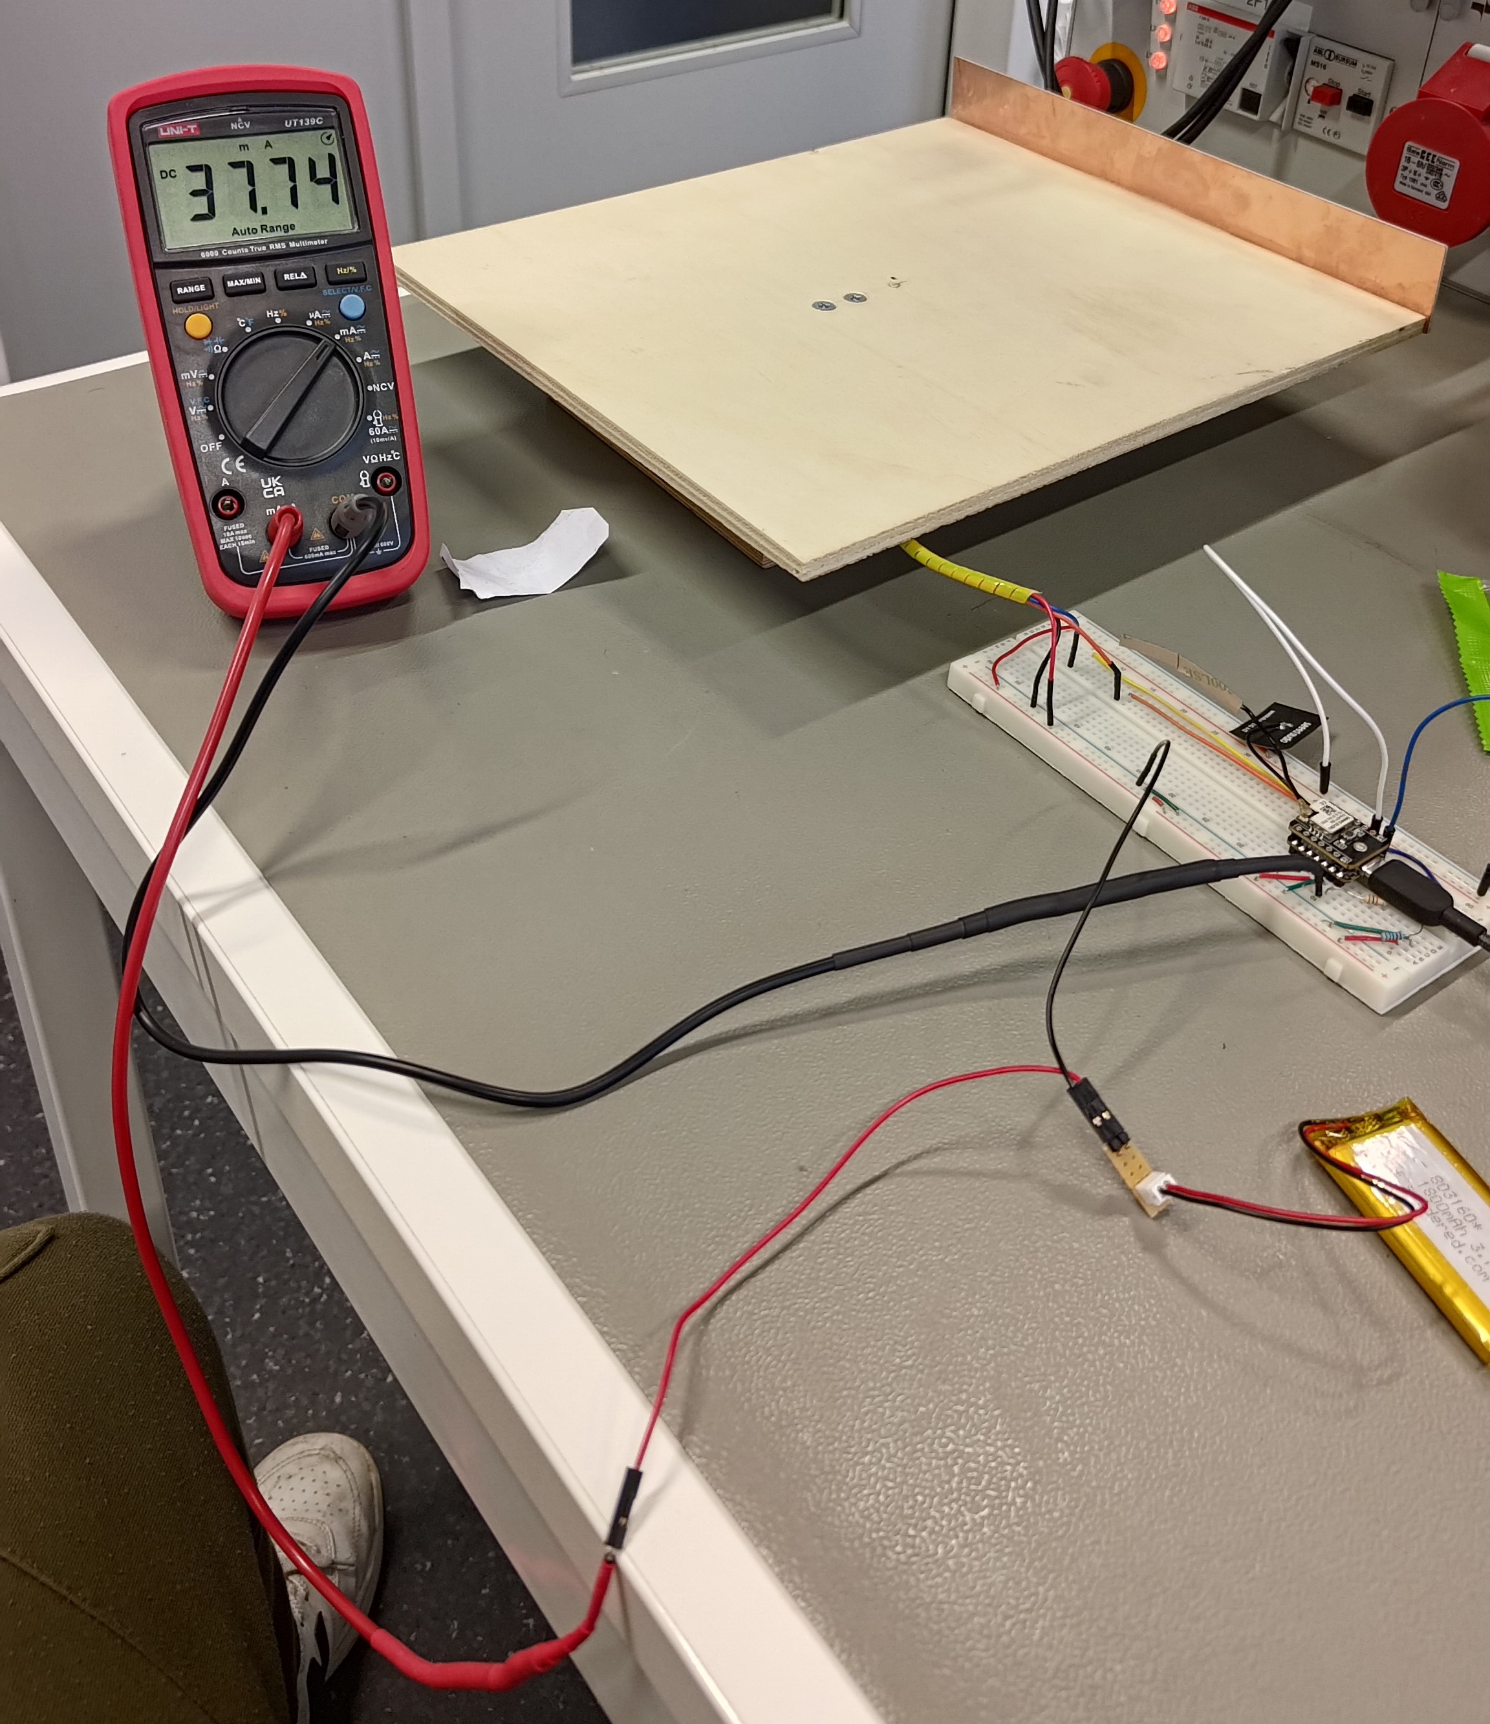
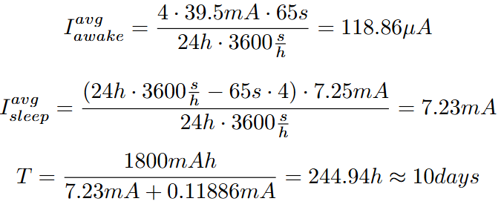
Power Consumption
39.5mA during uplink
7.25mA in sleep
4 uploads a day for 65s each

Slide 32
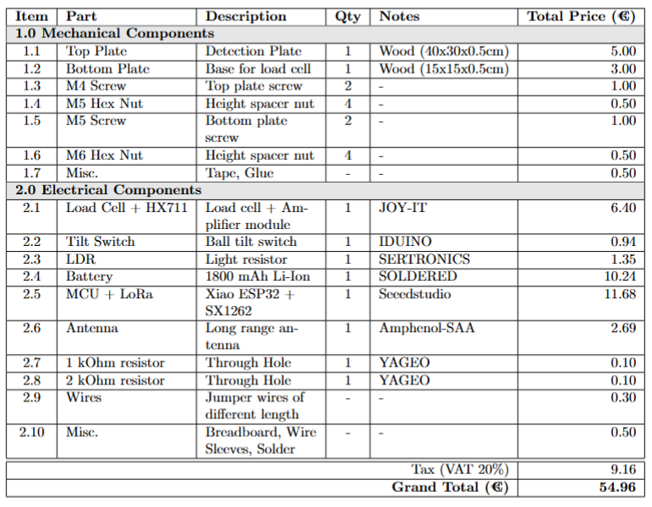

Slide 33
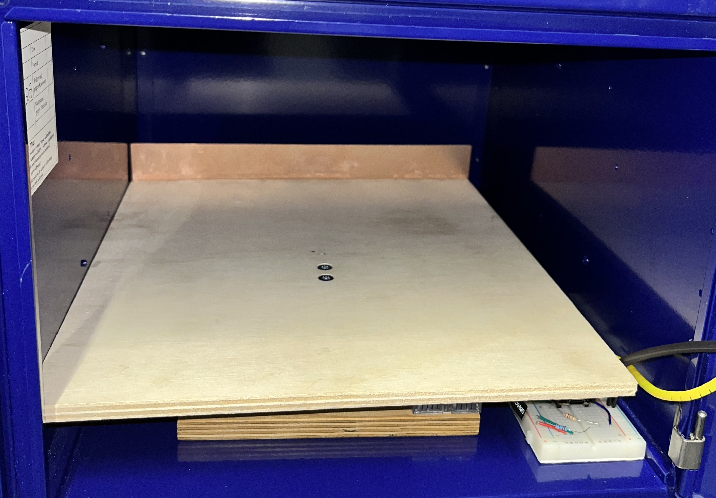
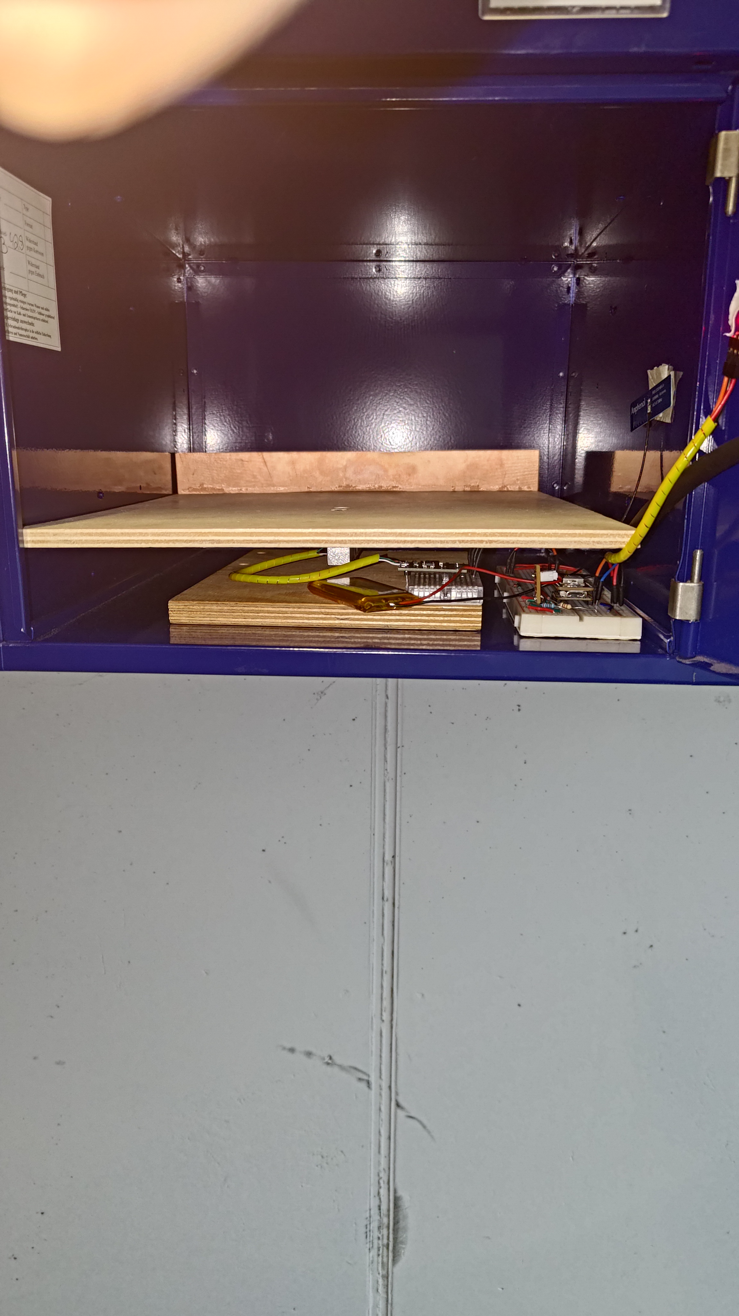
Complete System Pics

Slide 34
Sensor Interfacing
First Prototype
Notes:
AKK
To ensure the load cell bends as easily as possible, it must be installed into a platform
We see that there is a distance between the plates and the cell itself to ensure sufficient deformation
However, the load cell also another important design process - calibration

Slide 35

Sensor Interfacing
Load Cell Calibration
Notes:
AKK
we essentially just weighed and object with a scale and then placed the same object onto the load cell. The reading we got then allowed us to find the scaling factor by simply dividing the reading by the weight. We did this a few times and averaged the values to get the scaling factor we used in the code.

Slide 36
Sensor Interfacing
Housing Improvements
Notes:
AKK
We improved the housing ny making the top platform bigger and securing the HX711 to the base as we had an incident where the wires came loose

Slide 37
Application Layer
Device ID
Mail Status
Decode the Payload
Battery ID
Battery Status
Notes:
AK

Slide 38
Decode the Payload
Application Layer
Device ID
Data
server.py
Website
Mail
Machine
Notes:
AK

Slide 39
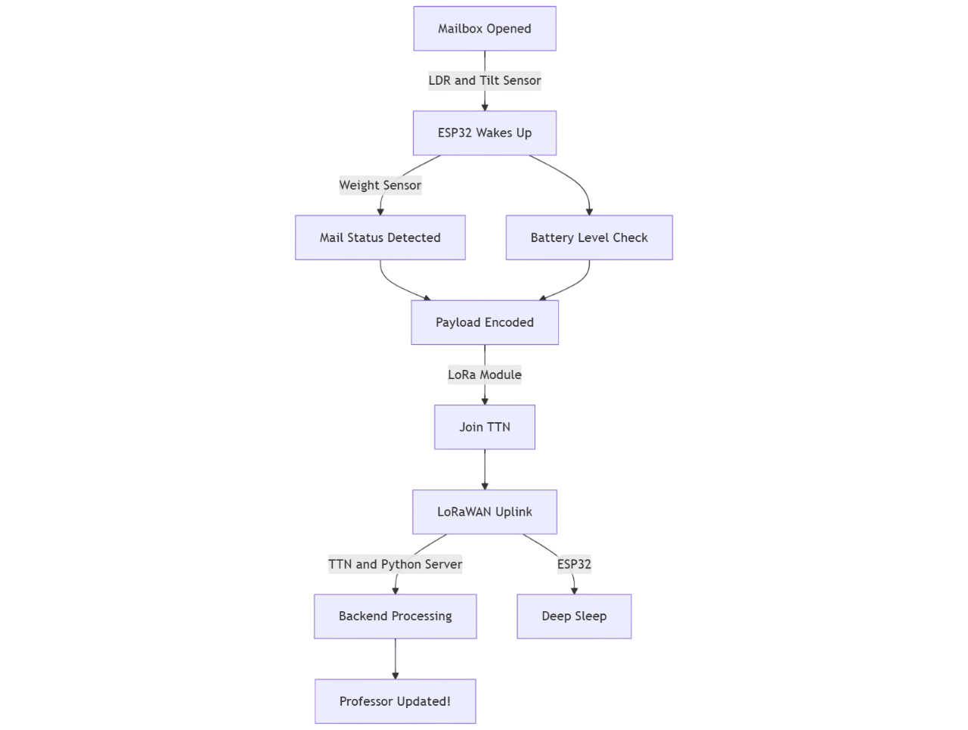
Our Approach
Detect
opening
Mail Status Detection
A combination of Light and Tilt Sensors to detect opening
Use a weight sensor to detect presence if mail and classify amount
Notify personnel
Monitor
battery
Detecting post triggers LoRaWAN gateway notification (website/mail)
Check voltage levels, in case it drops below a threshold, alert the user
Notes:
Use a weight sensor to detect if a post comes in

Slide 40
Price Estimates
Component | Price Estimate [EUR]
Weight Sensor | 8.00
Digital Tilt Sensor | 3.00
ESP 32 + LoRa Module + Antenna | 15.00
LDR | 1.00
Battery | 9.00
Housing estimate (extreme case) | 20.00
Total | 55

Slide 41


Solution: The Talking Mailbox
Check post
Your mailbox knows when something arrives
Weight sensor to detect post in box
Same sensor can detect when post is removed
Notify
The mailbox talks to you
Update a website to see if post is in the box
Optional: mail the respective person
Alert
Stay alert
Monitors battery and alerts user in case of low battery
Detects opening, and alerts user: avoid tampering

Slide 42
Product technologies and interaction
Weight
Sensor
Website/Mail
LDR
WiFi LoRa ESP32
LoRa Antenna
Backend Layer
Legend Communication
Wired LoRaWAN Internal server
Tilt Sensor

